Slide 1
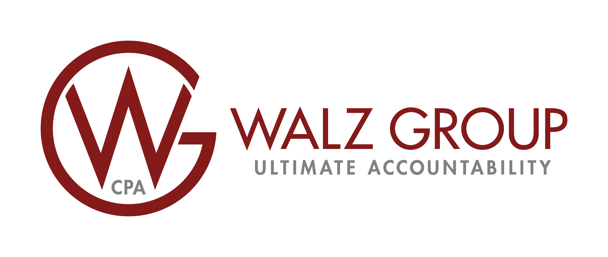

The Tangible Property Regulations Flowchart: Buildings
Routine Maintenance Safe Harbor
Perform activity more than once in a 10 year period
EXPENSE
Does the expenditure meet an exception to capitalization?
Expense
Test
DeMinimis Safe Harbor
AFS: written policy, $5,000 safe harbor Non AFS: policy, $2,500 safe harbor
Small Taxpayer Safe Harbor
Gross receipts ≤ $10 million, Unadjusted Basis ≤ $1 million,
Deduct the lesser of 2% unadjusted basis or $10,000
NO
Ameliorates a material condition or defect
Material addition to, or a major component of, the Unit of Property
Materially increase productivity, efficiency, strength, quality, or output
*If normal wear and tear occur during taxpayer ownership, return to initial state is not a betterment, If exact replacement is not available, improved but comparable replacement is not a betterment
Betterment
YES
Is the expenditure an improvement to the building’s systems or the building’s structural components?
or
BAR
Test
Adaptation
Adapts UoP to a new or different use from the ordinary use at the time originally placed in service
*1
or
Replacement of a component of property after properly deducting a loss
Replacement of a component that was sold
Replacement of property after claiming casualty loss
Returns UoP to ordinary, efficient operating condition after deterioration
Rebuilding of UoP to like-new condition after end of class life
Replacement of major component (40% test) or substantial structural part (25% test)
Restoration
*2
*3
NO
Unit of Property
Building Structure
Building Systems
-HVAC
-Plumbing
-Electrical
-All Escalators/elevators
-Fire protection and alarm system
-Security System
-Gas Distribution System
-Items that have different MACRS lives
Assets within UoP performing a major discrete function
YES
Is the expenditure material to its Unit of Property or material at the discrete function level within UoP?
Materiality
Test
CAPITALIZE
With option to write off remaining depreciable basis of existing asset using
YES
NO
EXPENSE
Partial Asset Disposition Election *3
our strength. your tax savings.
* See Reverse for Supplemental Information
*2
Version 2.0

Slide 2
Supplemental Information on Capstan’s TPR Flowchart: Buildings
CAPITALIZATION: 1.263A-1(a)(3)(ii) Taxpayers that produce real property and tangible personal property (producers) must capitalize all the direct costs of producing the property and the property's properly allocable share of indirect costs, regardless of whether the property is sold or used in the taxpayer's trade or business. Under Sec. 263(a), amounts paid to acquire, produce, or improve tangible property must be capitalized and not deducted.
*1. BAR TEST: At this level, if the expenditure is determined to be any one of these (Betterment, Adaptation, Restoration), it must be capitalized.
*2. RESTORATION: It may be difficult to determine whether a restoration is significant enough to require capitalization, as the regulations do not provide any bright-line quantitative threshold for decision making. However, changes to the examples in the final regulations do indicate some patterns, from which general guidelines may be extrapolated. See § 1.263(a)-3(k)(7) for relevant examples.
For major components of buildings and building systems, examples imply that a replacement of 40% or less of a major component may not be a significant portion of the major component, and as such would not be considered a restoration. [Example numbers 18, 21, 23 and 25.]
For substantial structural parts, examples indicate that replacement of 25% of a building’s structure was not considered a large portion of the substantial structural part, and therefore was not considered a restoration. [Example numbers 27 (30%) and 30 (25%).]
For discrete function, examples indicate that if a material component performs a discrete and critical function, it is a major component of the building. Incidental components of the UoP generally will not constitute a major component. Relevant example numbers include 14, 15, 16, 17, 18, etc.
*3. PARTIAL ASSET DISPOSITION ELECTION: There may be a tax planning opportunity for taxpayers who purchase and place assets in service and then begin renovation activities. Assuming that the assets are already "in service," that the UNICAP provisions of IRC Sec. 263A don’t apply, and that the safe harbor provisions pertaining to IRC Sec. 280B (demolition) have successfully been met (so that amounts are not capitalized to land), then taxpayers may be able to take a partial asset disposition election on the assets being disposed of in the renovation.
Additional Note: Detailed examples are contained in the IRS T.D. 9636 of 10.21.13 entitled, “Guidance Regarding Deduction and Capitalization of Expenditures Related to Tangible Property,” and in all subsequent IRS guidelines released on this topic.
DISCLAIMER: Capstan Tax Strategies, with its issuance of this Flowchart, is not providing tax, legal or accounting advice. This material has been prepared for informational purposes only. It is not intended to provide, and should not be relied upon for, tax, legal or accounting advice. Taxpayers should consult their personal tax, legal and accounting advisors before engaging in any transaction.
(717) 392-8200 | walzgroupcpa.com

