Slide 1
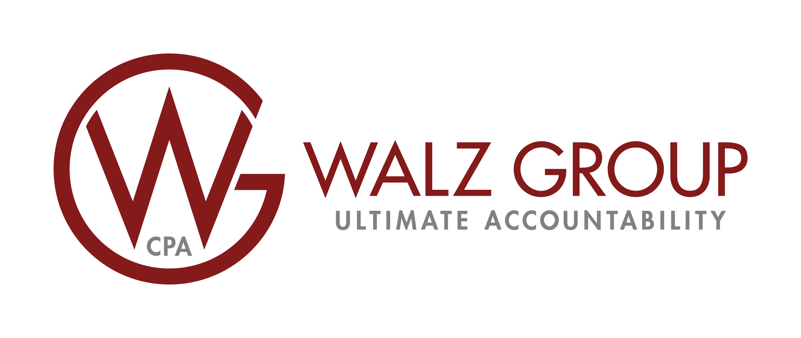




HIERARCHY OF EXPENSING 1/20/2025 and BEYOND
Expense Under the Tangible Property Regulations
Does De Minimus Safe Harbor Apply? OR
Does Routine Maintenance Safe Harbor Apply? OR Can asset be written off using BAR/Materiality testing?
 | Section 179 Expensing | Bonus Depreciation
Applies to New Assets
Applies to Used Assets
Applies to Personal Property
Applies to Elected Qualified Real Property
Represents 100% Expensing of Asset
Applies to Qualified Improvement Property (QIP)
Applies to Commercial Roofs, HVAC, Fire Protection, Security Systems
Subject to Overall Business Income Limitation
Requires an Affirmative Election Made in the Year the Asset is Placed-In-Service
Can Be Used Retroactively Through CSS Look-Back Study
Associated Expensing Limit with Inflation Adjustment ($2.5M –2025)
Associated Phase-Out with Inflation Adjustment ($4.0M –2025)
May Apply to Property Used 50% or Less for Business (Except Listed Property)
Requires Recapture if Business Use of Property Falls to 50% or Less (Except Listed Property)
YES
NO
Asset Expensed
Asset Capitalized
Consider Partial Asset Disposition Election to write off remaining depreciable basis of replaced asset
Eligible for Section 179
Expensing?
OR
100% BONUS Depreciation
on Assets with MACRS Lives of 20-years or Less
MACRS Class Lives Used to Depreciate Remaining Basis
walzgroupcpa.com.com
DISCLAIMER: Walz Group, with its issuance of this chart, is not providing tax, legal or accounting advice. The above summary does not apply in every scenario applicable to Sec. 179 and/or Bonus depreciation and their respective limitations. This material has been prepared for informational purposes only. It is not intended to provide, and should not be relied upon for, tax, legal or accounting advice. Taxpayers should consult their personal tax, legal and accounting advisors before engaging in any transaction.
© Copyright 2021-2025 Walz Group. All rights reserved.
capstantax.com 1

